Slide 1
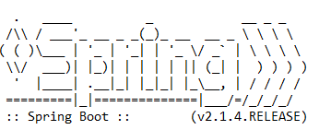
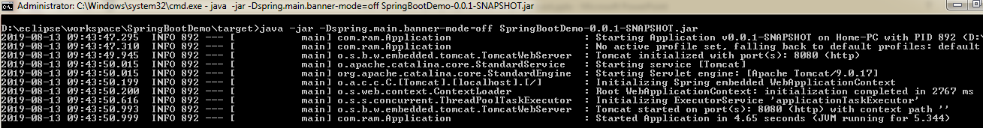
How to disable spring logo banner in spring boot?
By default, all spring boot applications will show up below spring logo banner in all spring boot applications.
java -jar -Dspring.main.banner-mode=off SpringBootDemo-0.0.1-SNAPSHOT.jar

